Slide 1
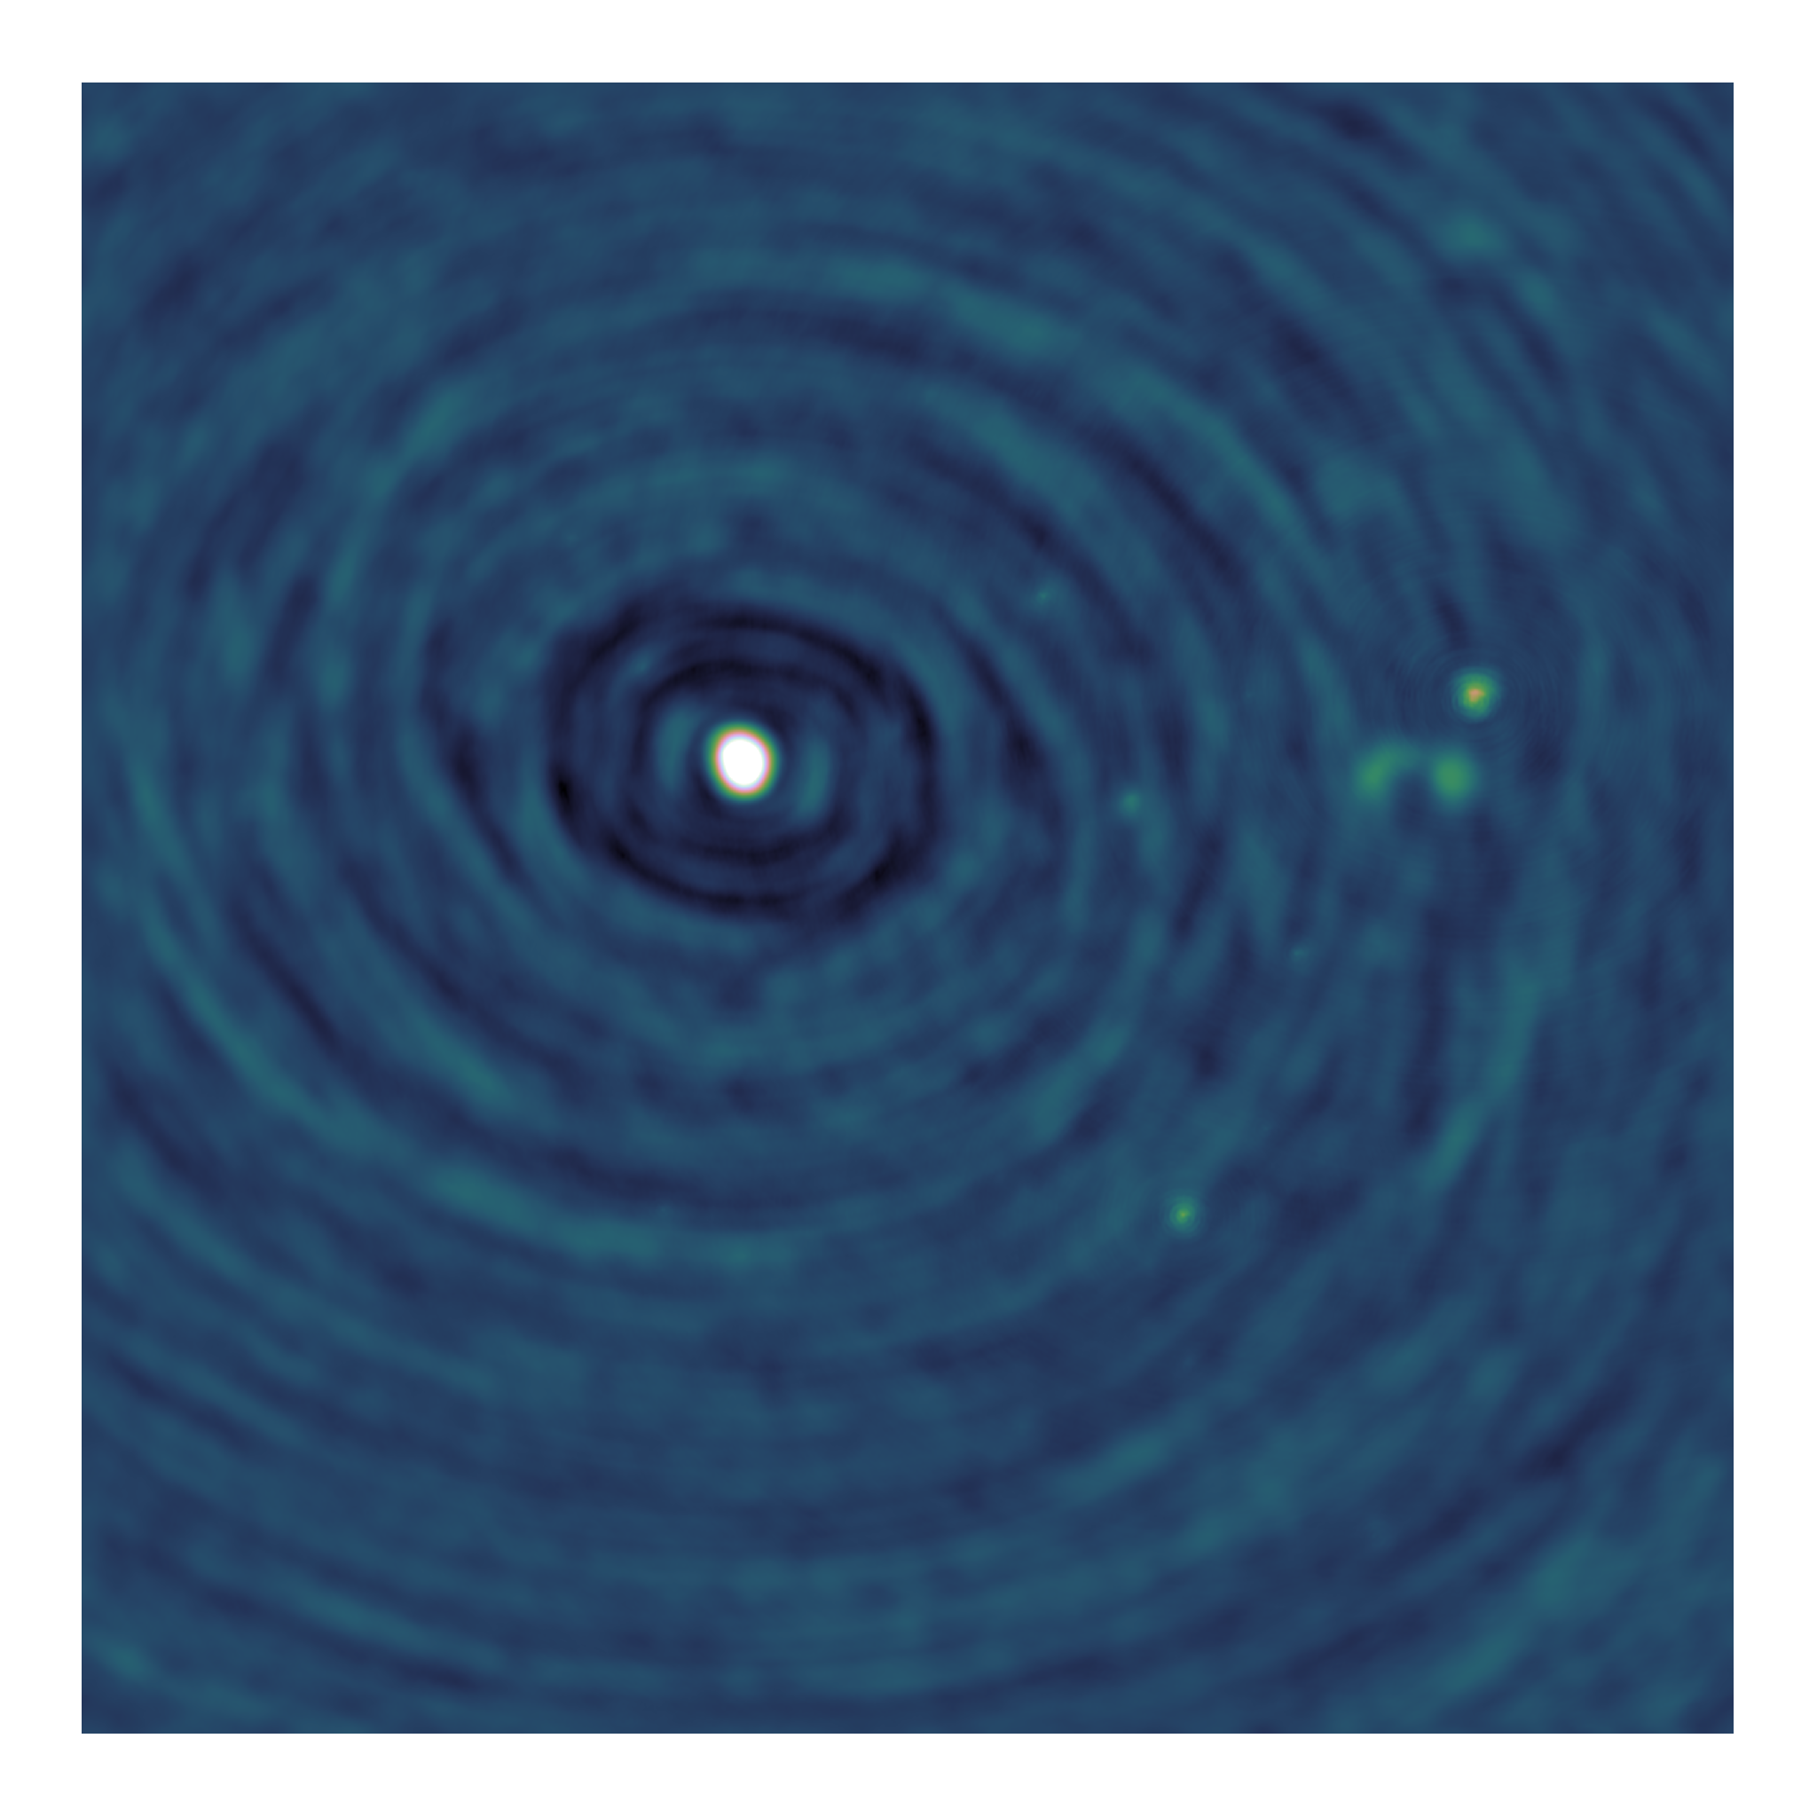
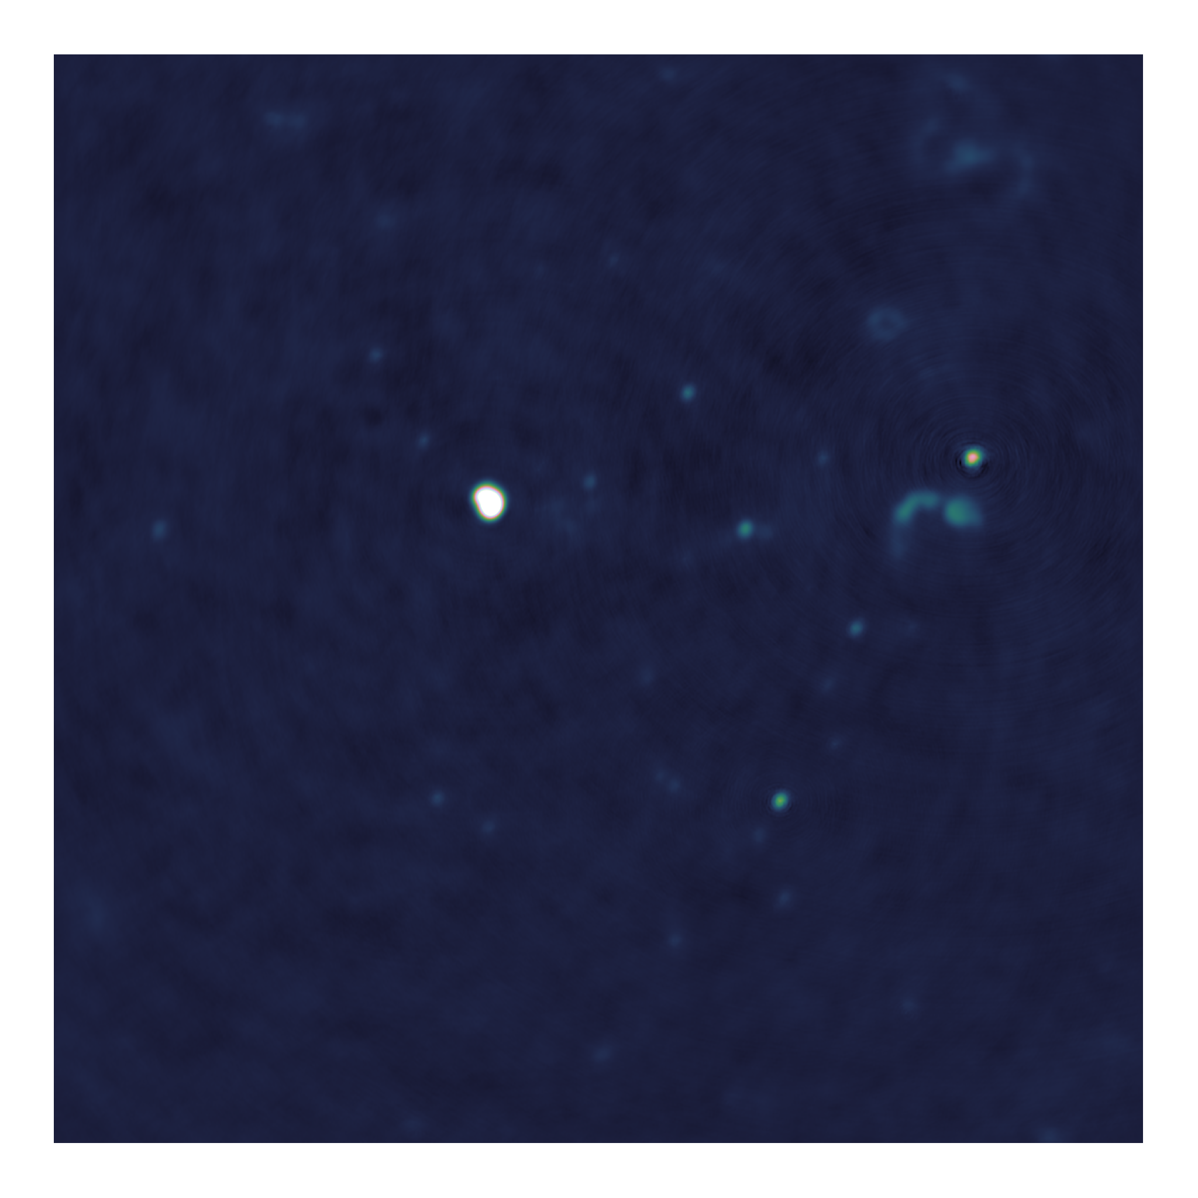
Towards distributed image reconstruction

Slide 2
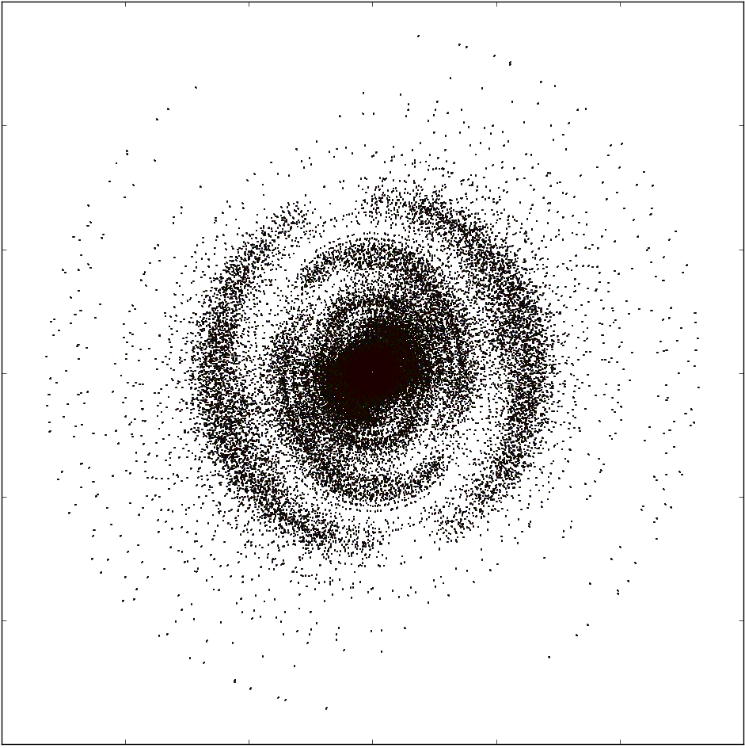
Measurements of the Interferometer
Measurements
Dirty Image
Dirty Image

Slide 3
Deconvolution
Major cycle, deconvolution

Slide 4
Major/Minor cycle
Major Cycle, Visibilities to Image
Minor Cycle, deconvolution

Slide 5
Minor Cycle algorithm
CLEAN
Parallel coordinate descent

Slide 6
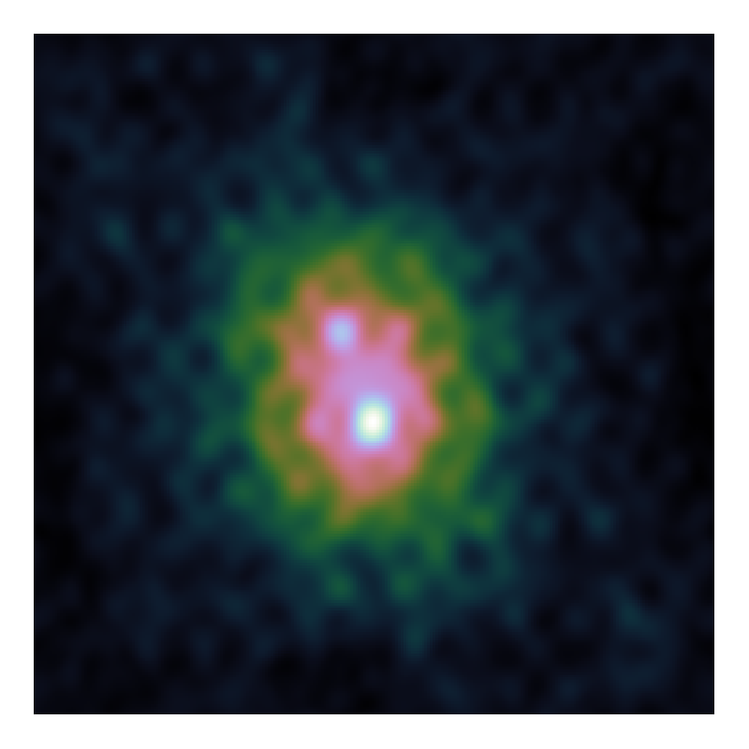
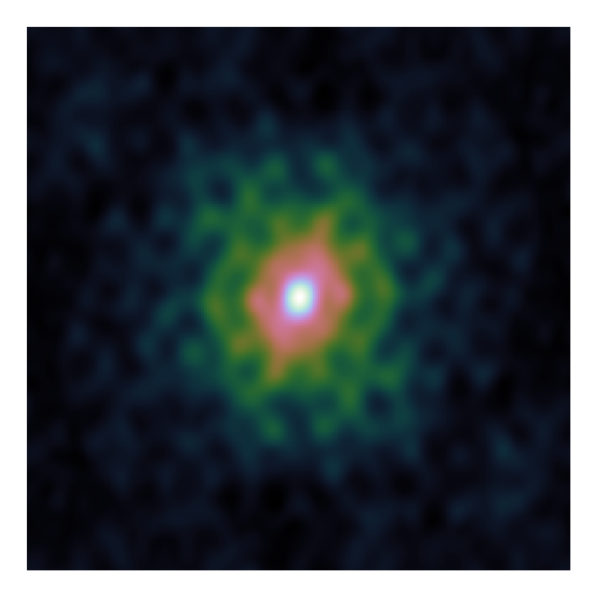
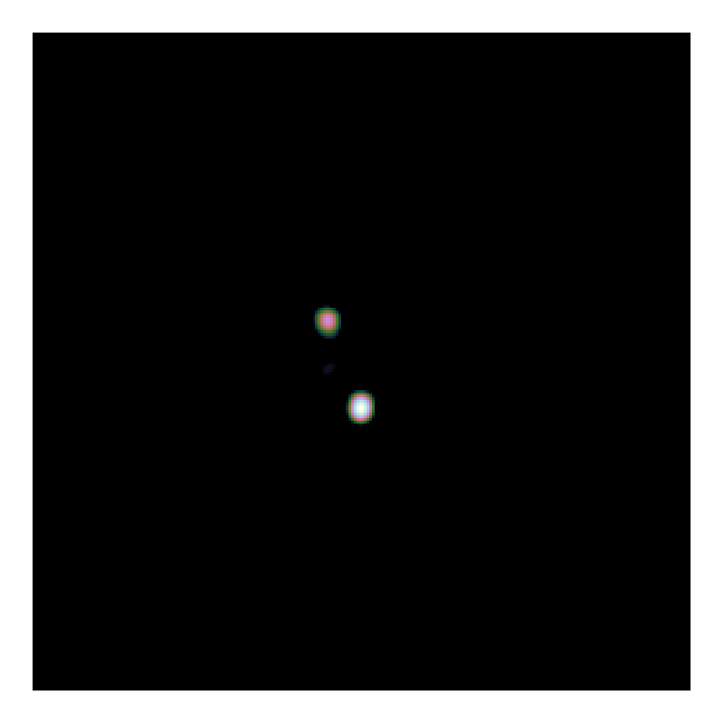
CLEAN

Slide 7
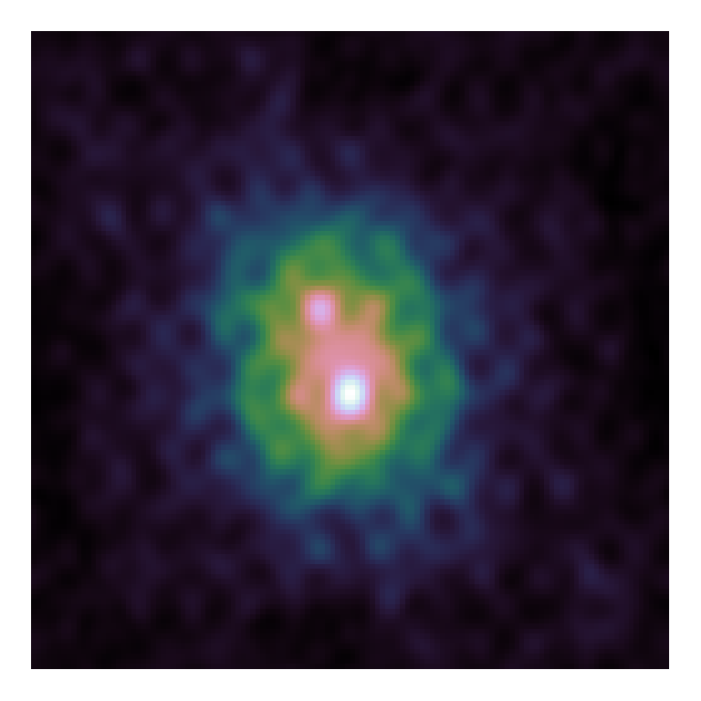

CLEAN

Slide 8
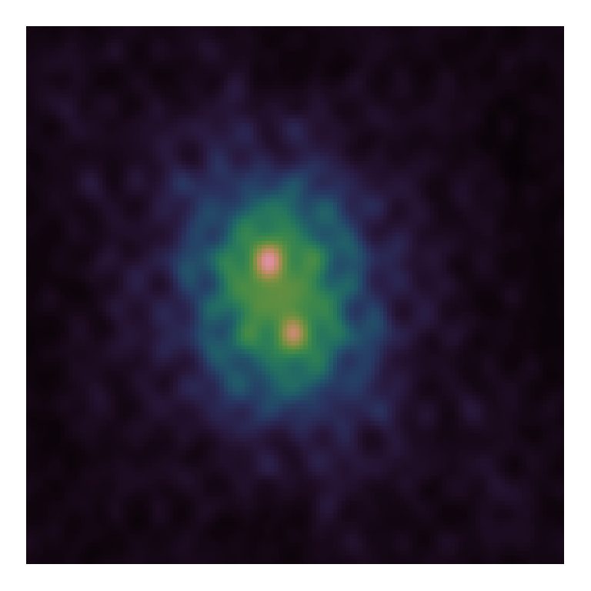

CLEAN

Slide 9
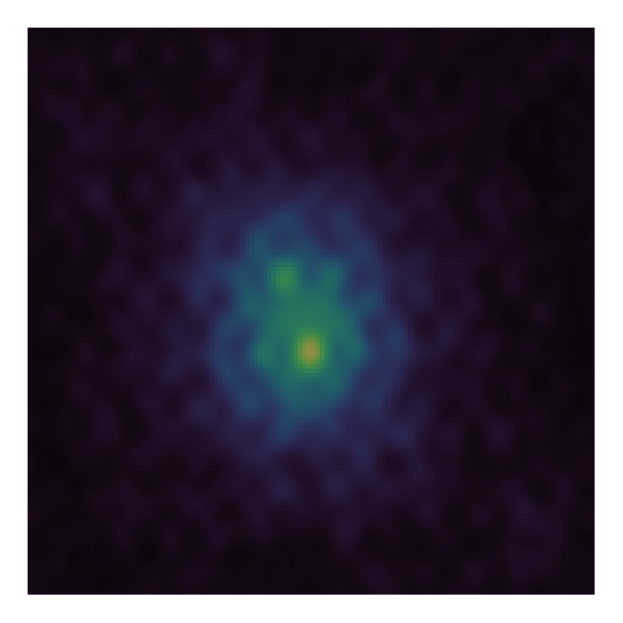
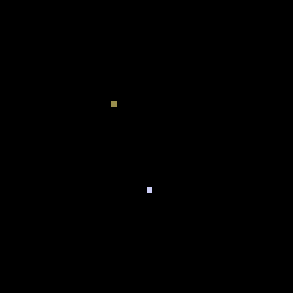
CLEAN

Slide 10
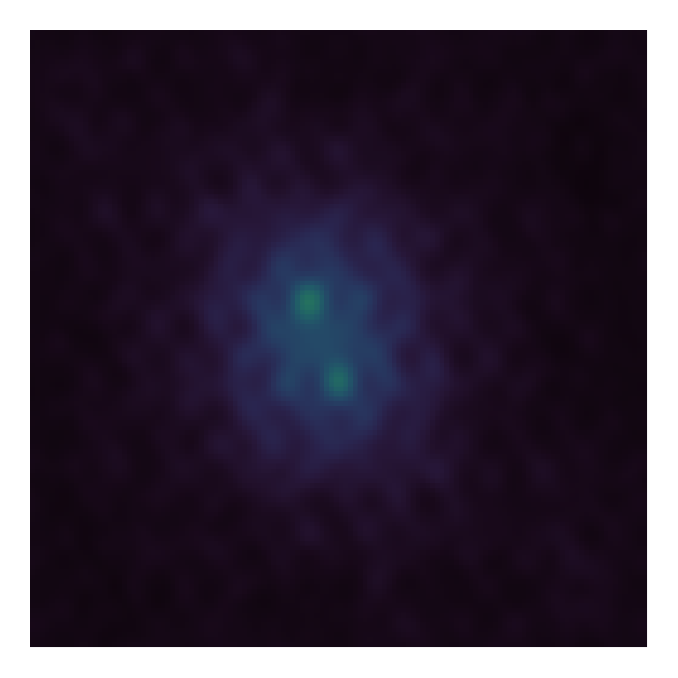
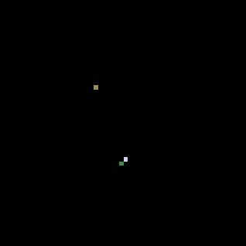
CLEAN

Slide 11
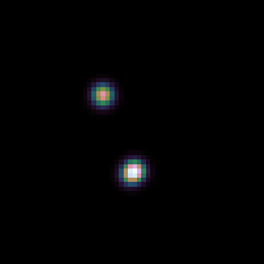
CLEAN

Slide 12
Multi-scale CLEAN

Slide 13
Problems with CLEAN

Slide 14
Elastic Net Regularization

Slide 15
Gradient calculation

Slide 16
Serial Coordinate Descent
Again, show gradients

Slide 17
PSF Approximation

Slide 18
Parallel Coordinate Descent

Slide 19
ESO Image

Slide 20
ESO

Slide 21
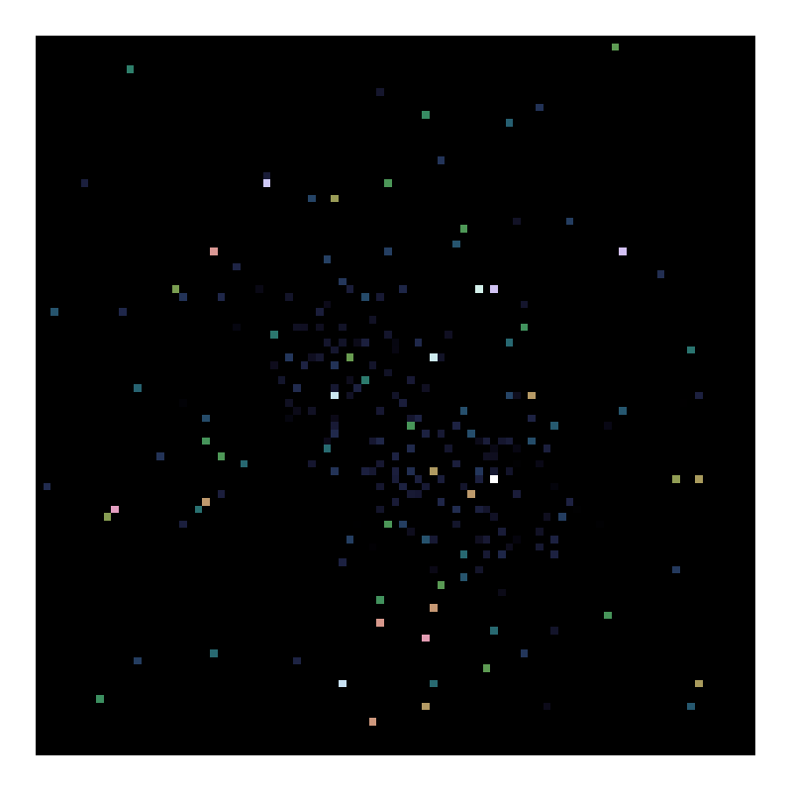
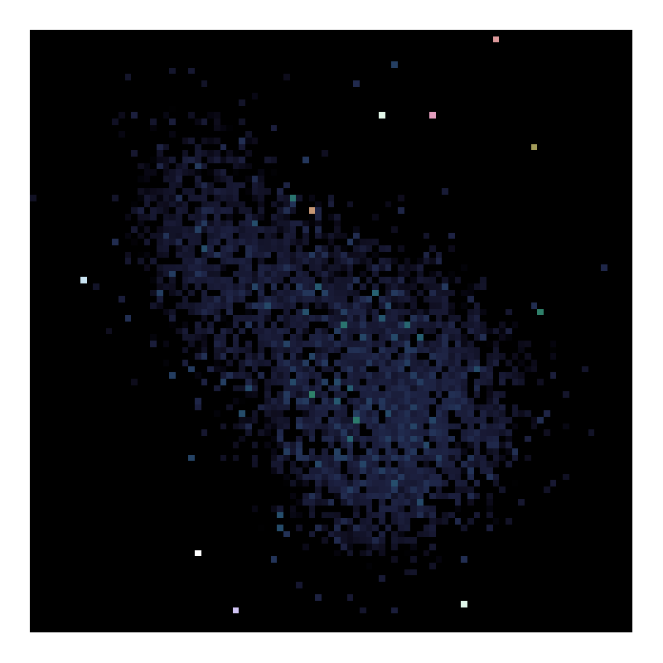
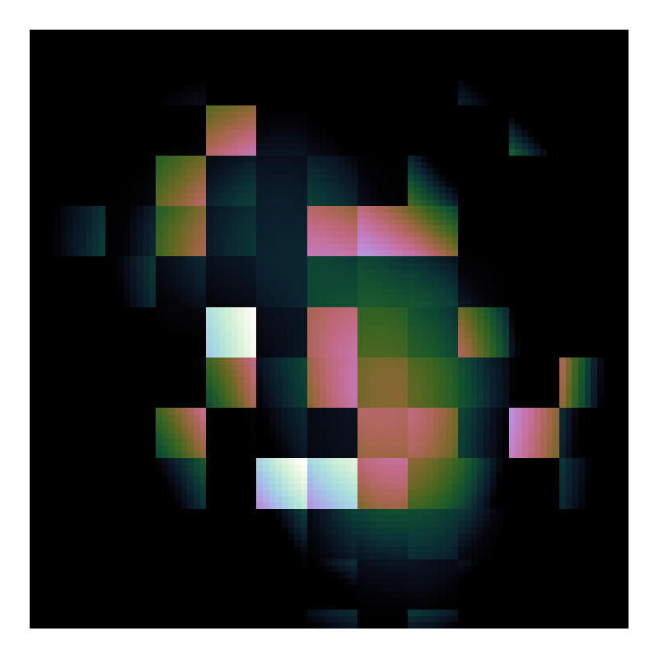
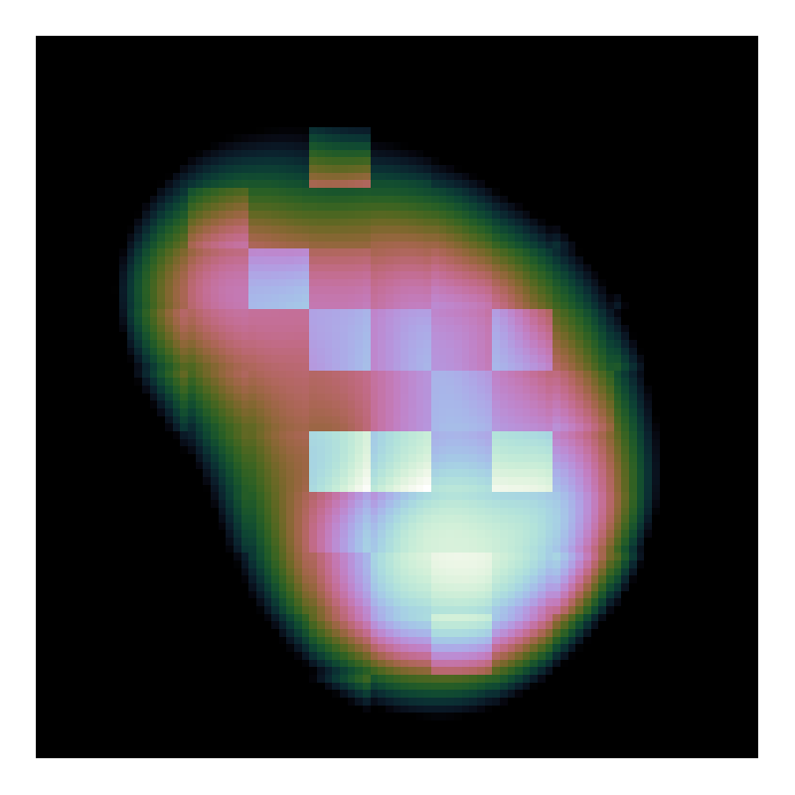
Problems on the deconvolution

Slide 22
Search Factor

Slide 24
LMC Observation

Slide 25
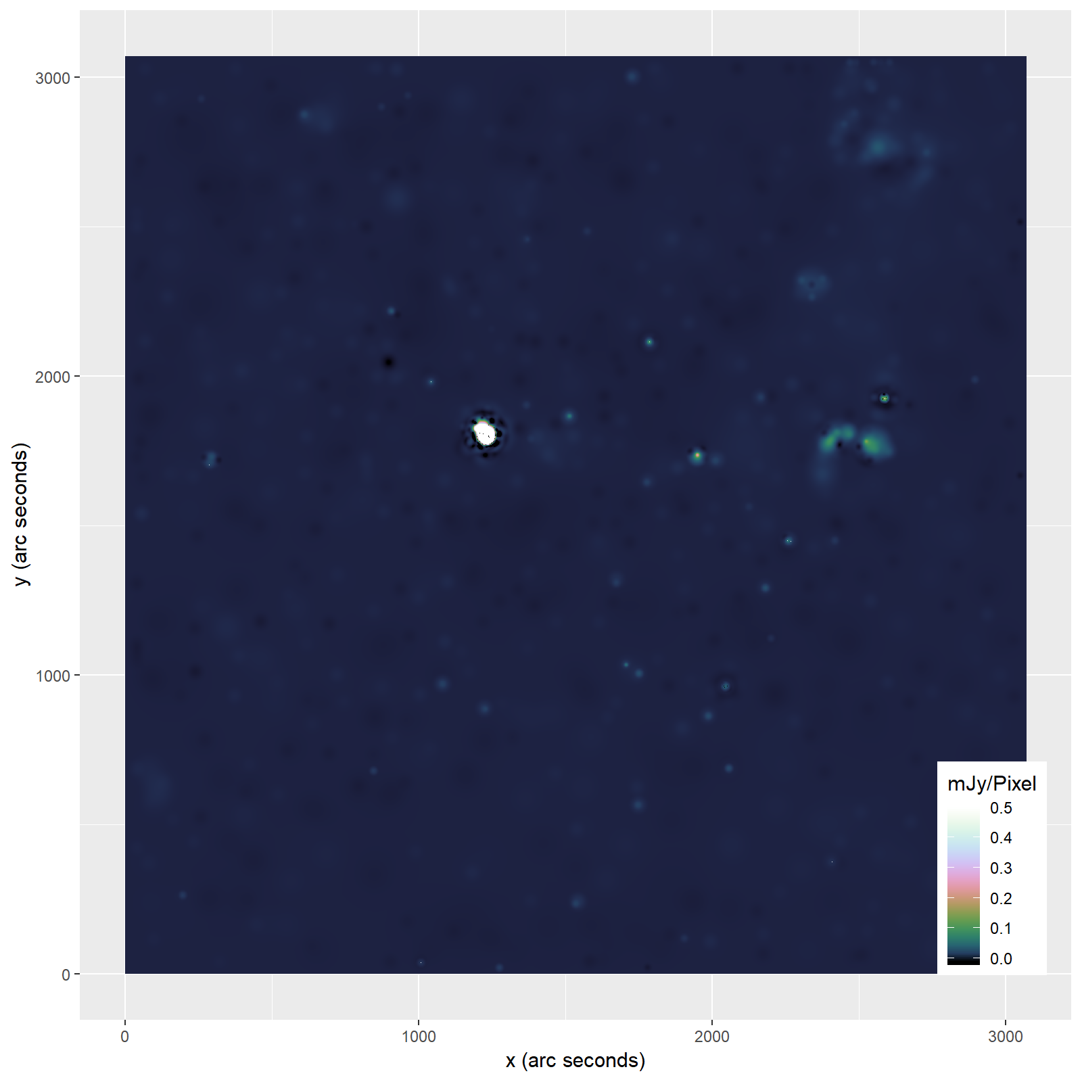

Slide 26
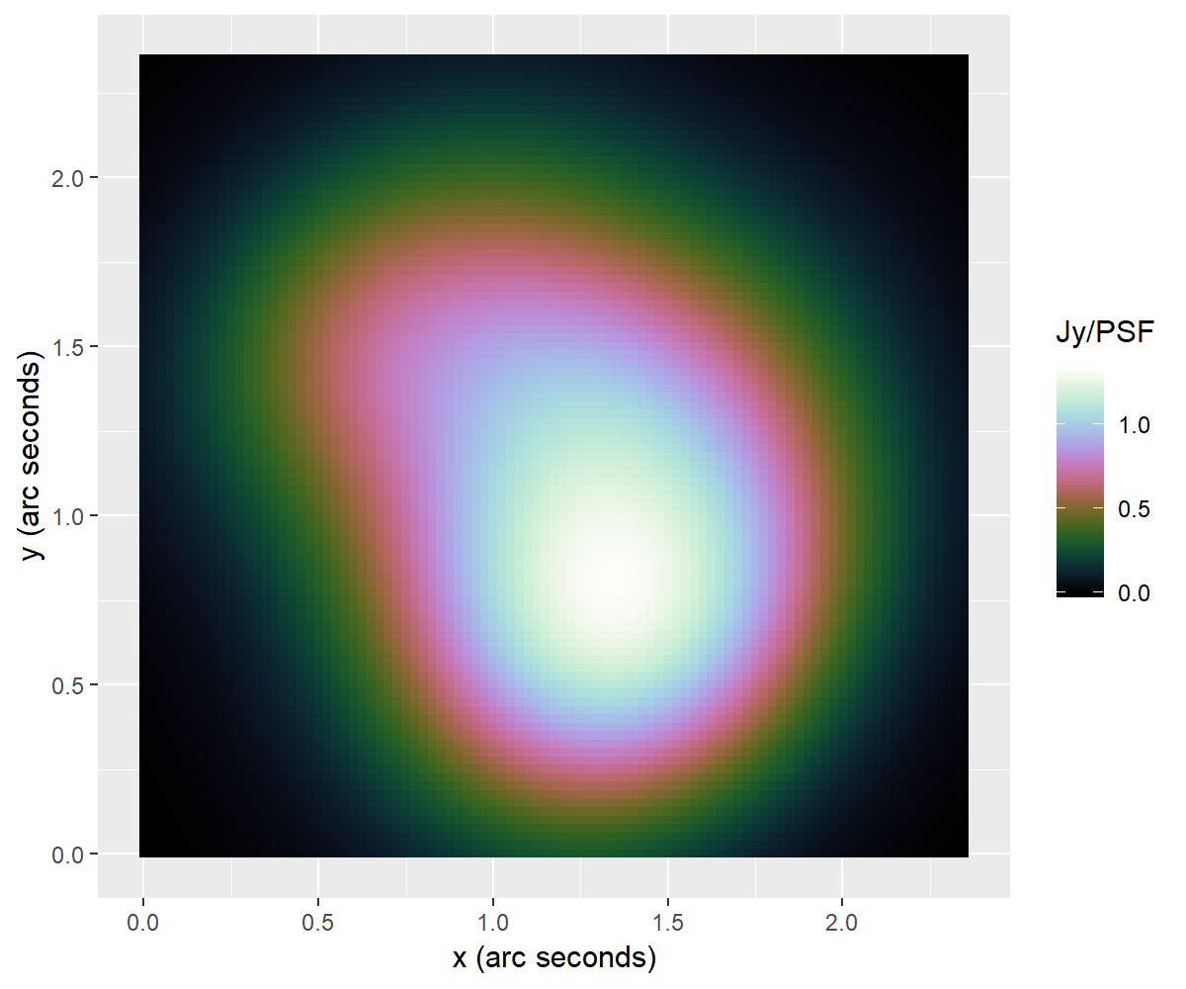
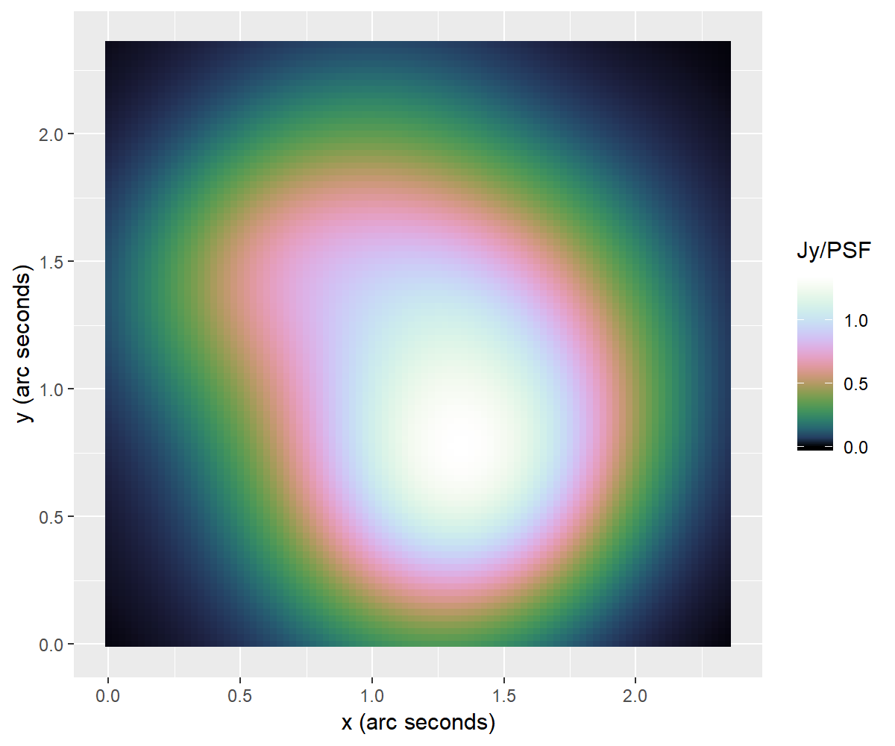
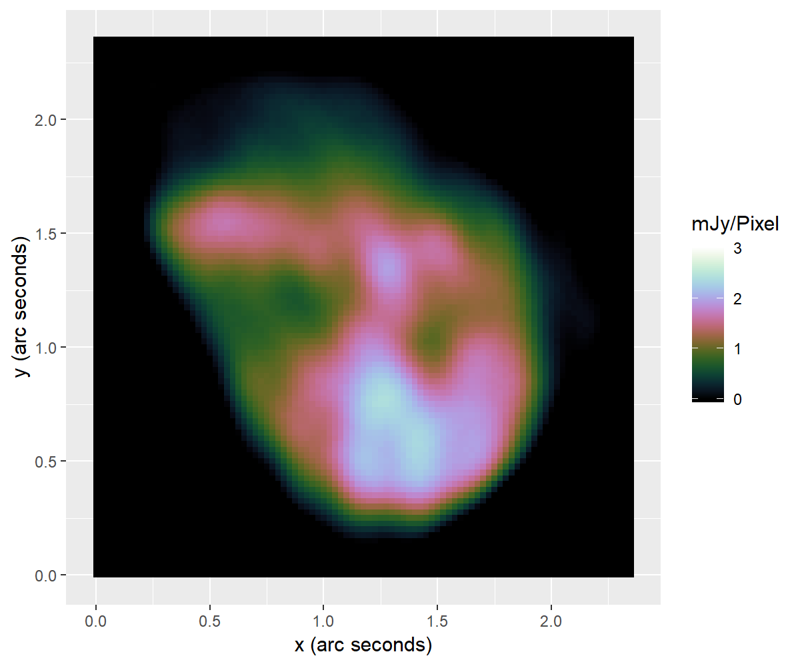
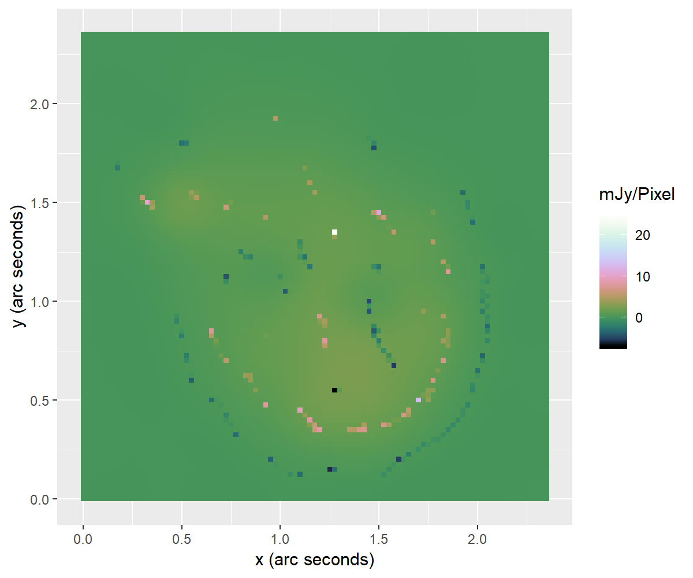

Slide 27
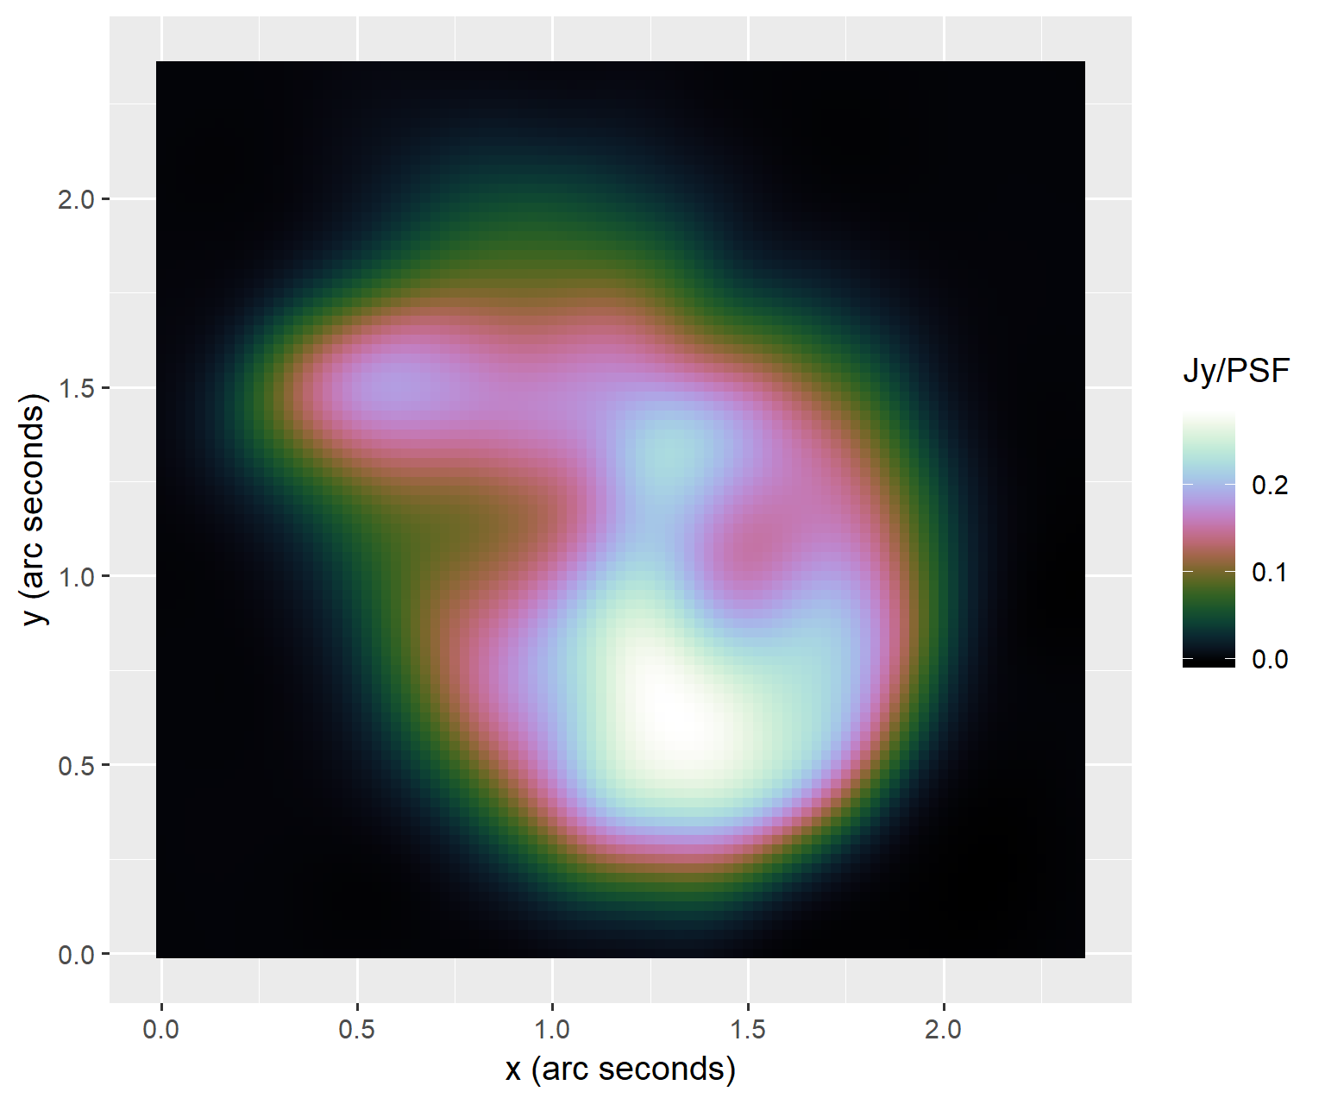

Slide 28
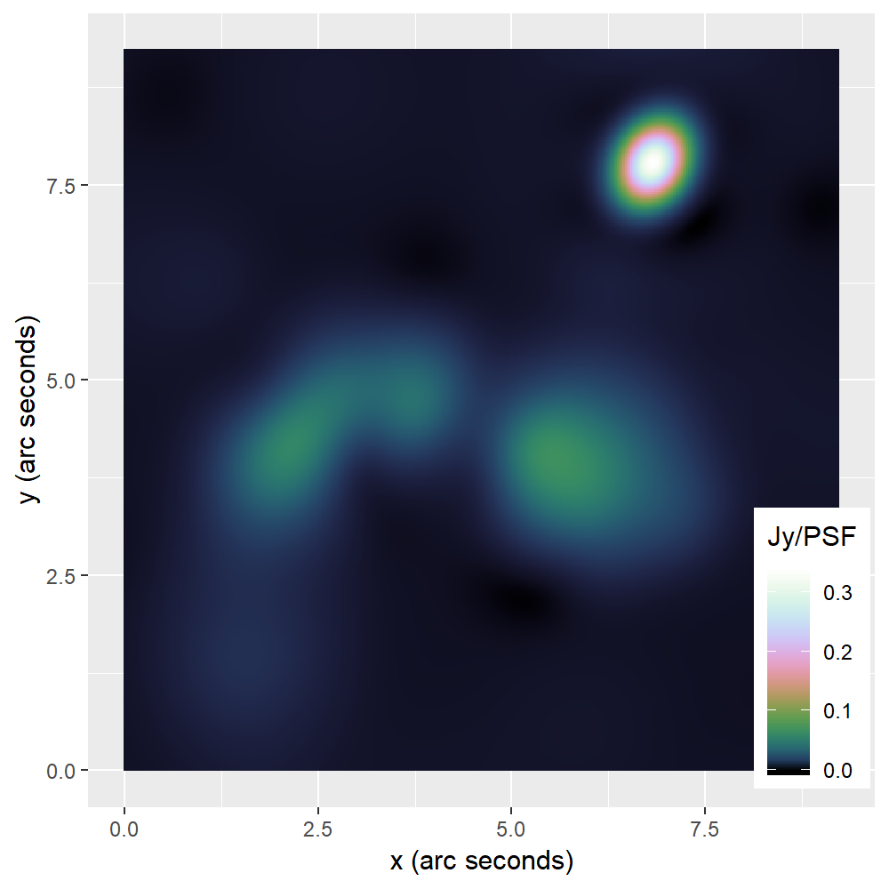
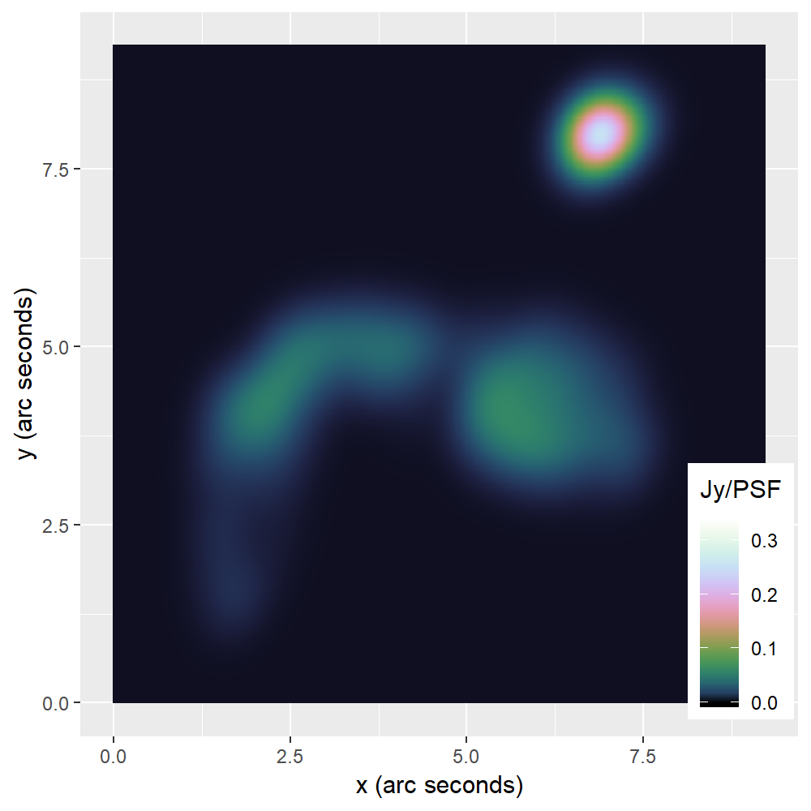
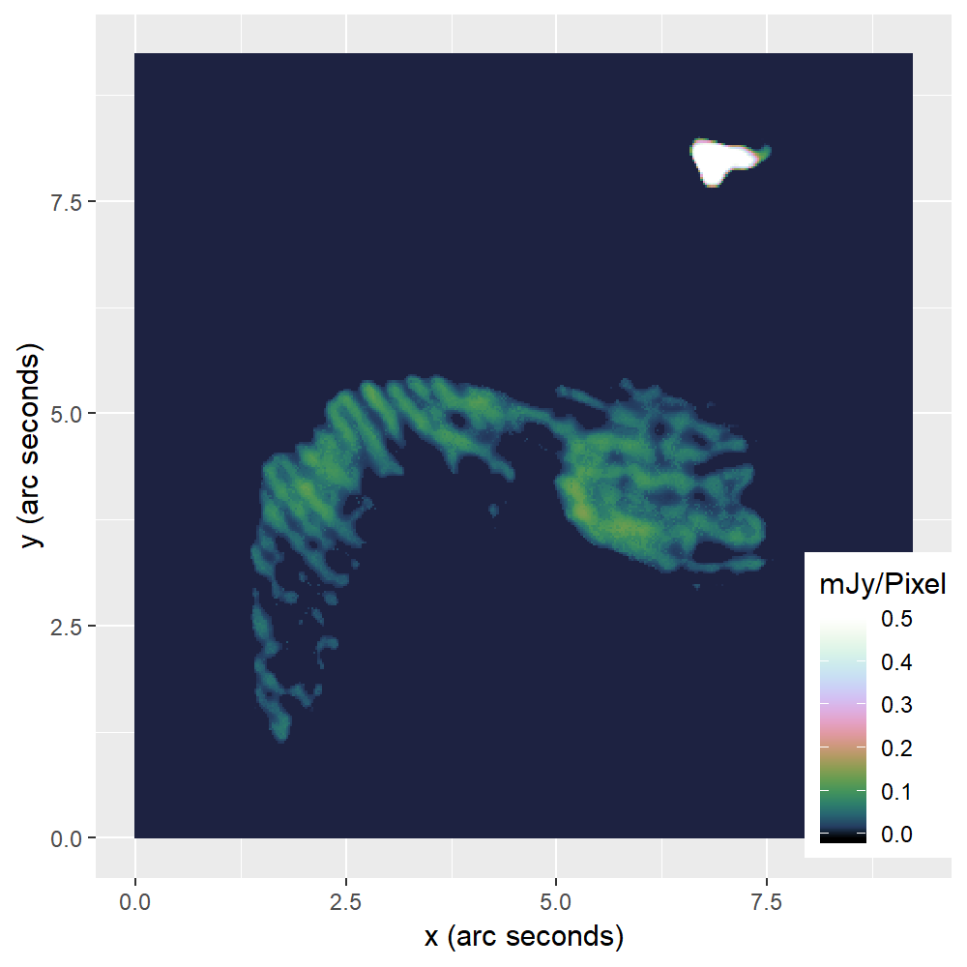
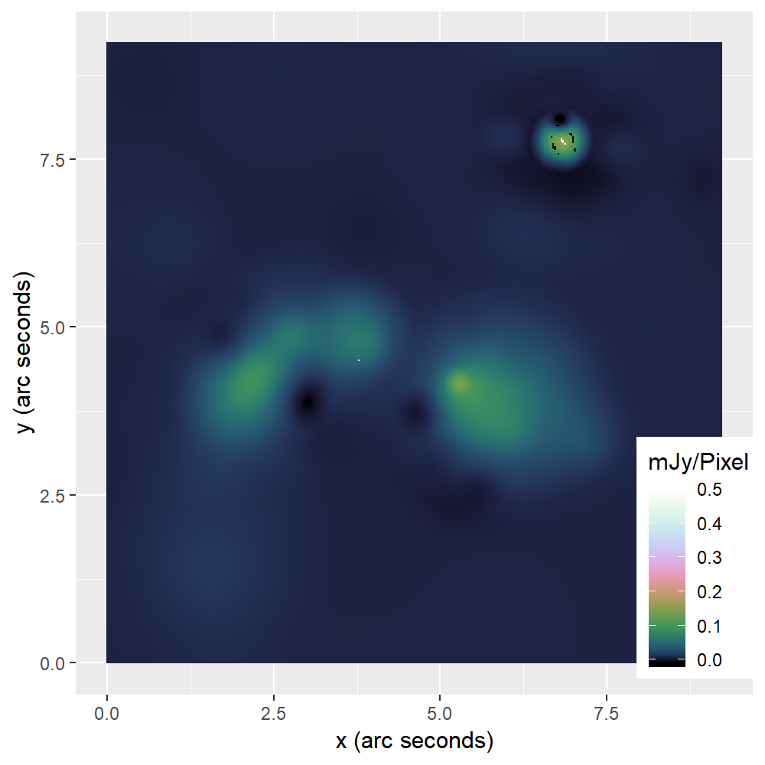

Slide 29
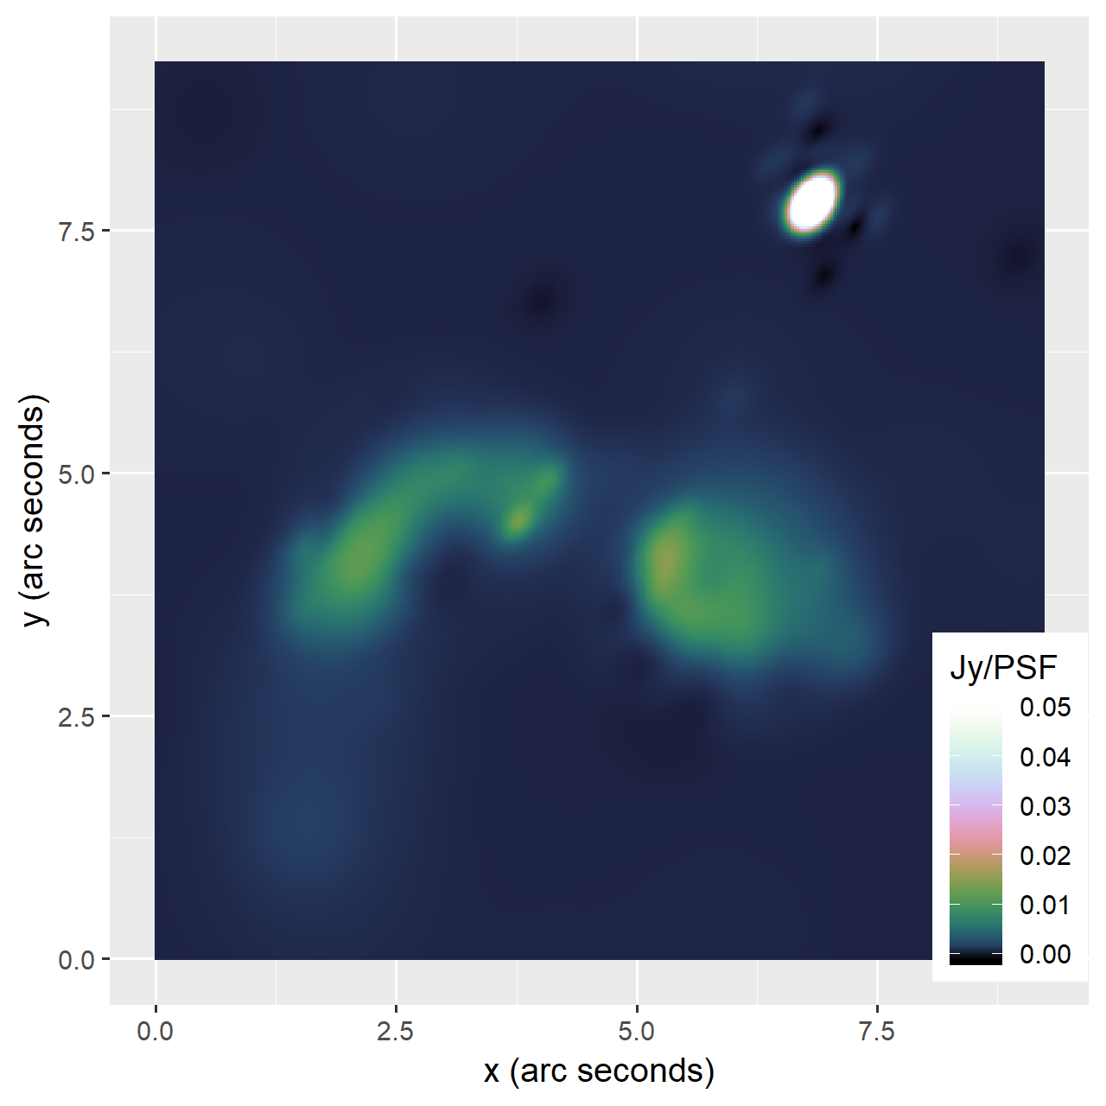

Slide 30
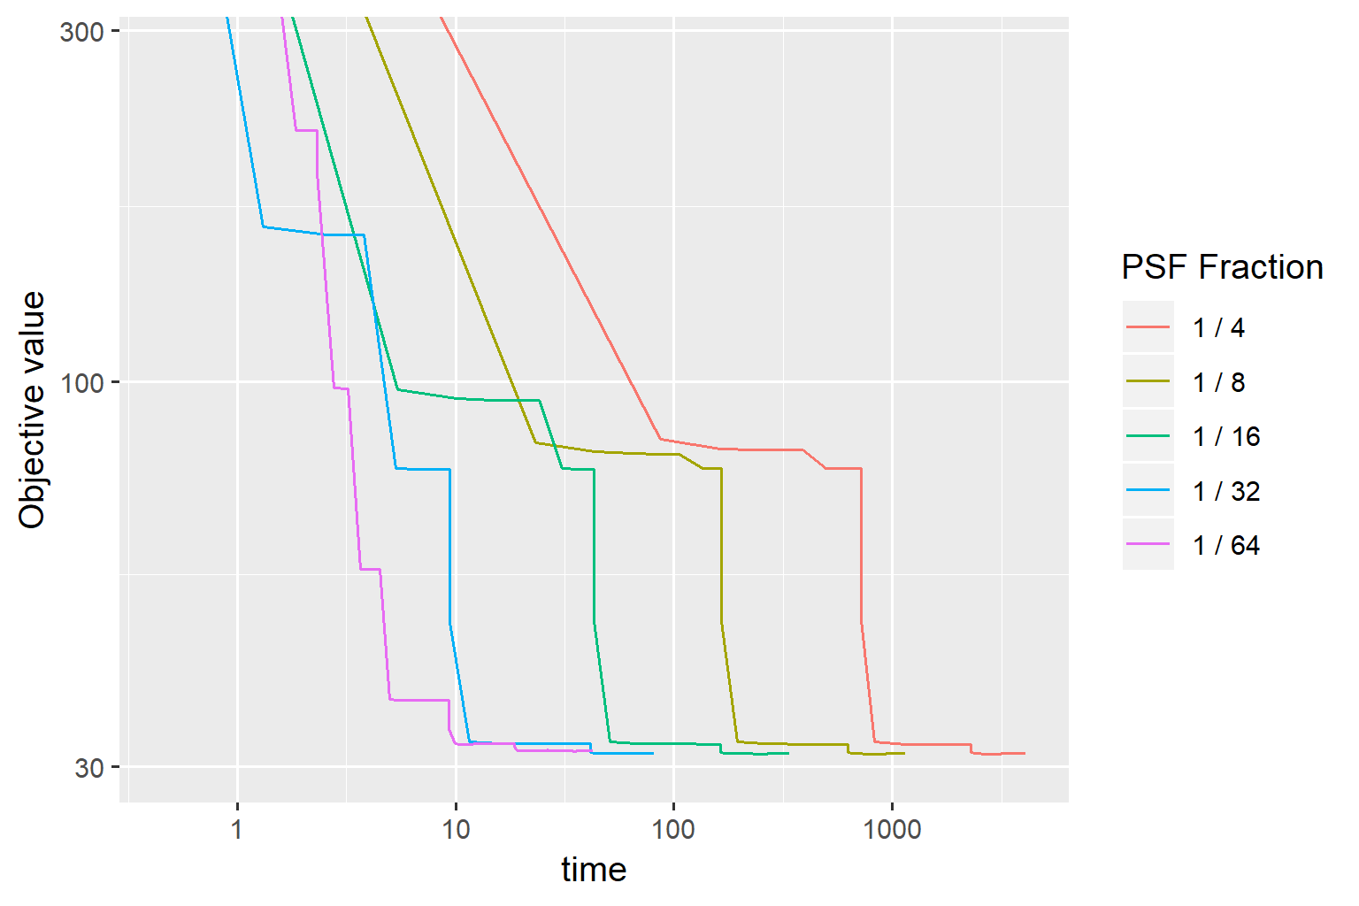
Speedup PCDM

Slide 31
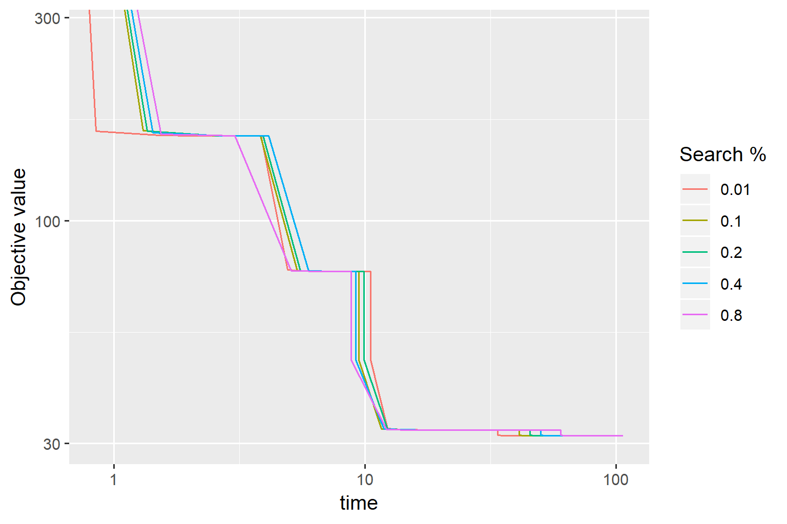

Slide 32
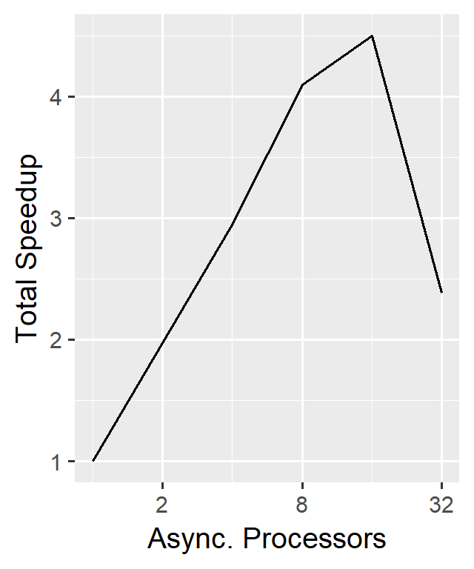
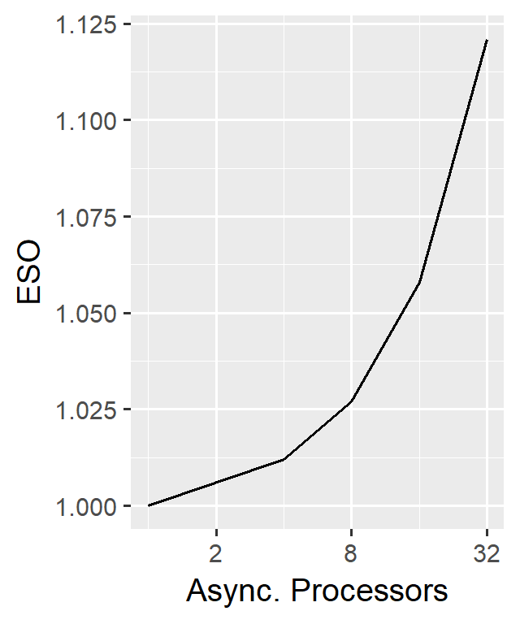
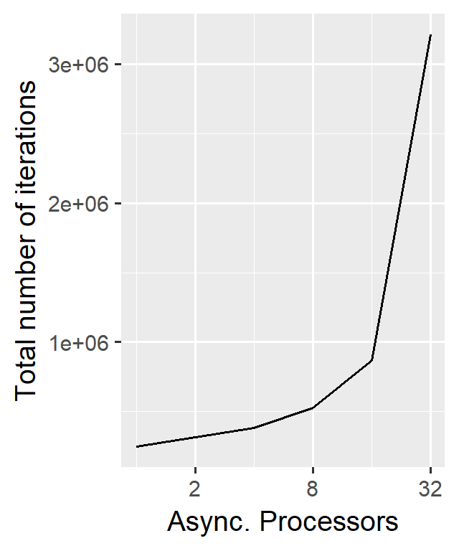
Scalability

Slide 33
Test
Table

Slide 34
Speed comparison to CLEAN

Slide 35
Conclusion
Problem with facets
How much distribution
How useful is elasticnet

Slide 36
Conclusion 2
Fast algorithm. Possible to distribute

